Slide 1



TeachTrack
Faculty Evaluation & Feedback System
Presented by
Devinity
Next Slide

Slide 2
Introduction
What is TeachTrack?
A smart Faculty Evaluation & Feedback System to improve teaching quality
Helps faculty grow through actionable insights
Simplifies feedback management for administrators
Inspiration:
Driven by the need for transparency and academic improvement
Combines ease of use with strong data-driven features
Key Strengths:
Anonymous student feedback
Professional growth insights delivered through insightful dashboards.
Secure, user-friendly interface with powerful analytics
Efficient feedback management for administrators to drive data-driven decisions.
Next Slide

Slide 3

Project
Smart & Intuitive System for managing faculty evaluation
Anonymous Student Feedback to encourage honest responses
Insightful Faculty Dashboard for self-assessment
Admin Control Panel for managing users and feedback reports
Role-Based Access for Students, Faculty, and Admins
Secure & User-Friendly Interface for all users
Centralized MySQL Database for efficient data storage
Analytics & Reporting to support data-driven decisions
Goals
Next Slide

Slide 4
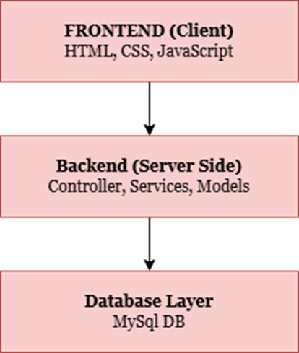
Technology Used
Backend
Java – Core programming language
Spring Boot – Framework for building secure REST APIs
Frontend
HTML, CSS, JavaScript – Standard web development stack
Database
MySQL – Relational database for storing feedback and user data
Tools & Environment
Visual Studio Code – Code editor for frontend development
Git & GitHub – Version control and collaboration
Next Slide

Slide 5
Requirement
Functional
The system shall allow users (Admin, Faculty, and Students) to securely log in with a username and password.
The system shall allow students to submit anonymous feedback through a structured form.
The system shall allow faculty to manage their profile settings and notification preferences.
The system shall allow the admin to view a dashboard with total students, faculty, and courses.
The system shall allow the admin to manage courses (add/edit/delete course records).
The system shall validate all inputs and provide meaningful error messages on failure.
Next Slide

Slide 6
Non-Functional
Requirement
Strong Security: Encrypted passwords & role-based access control; anonymous feedback option.
Audit Logging: Admin activities should be recorded for transparency and monitoring.
User-Friendly & Beautiful Interface: Designed for easy navigation and quick task completion.
Efficient Data Handling: Supports over 10,000 feedback records without lag or crashes.
Scalability: Can be expanded to new institutions with minimal setup.
Maintainability: Modular architecture to support quick updates and bug fixes.
High Performance: Handles up to 500 concurrent users with fast feedback submission (~3 seconds).
Next Slide

Slide 7
User
Stories
02
03
04
01
View and Filter Feedback
Login Authentication
View Dashboard
Submit Feedback
As an admin, I want to view the dashboard , so that I can access essential administrative tools easily.
As a student, I want to submit feedback anonymously/un-anonymously so that I can express my opinions.
As a faculty member, I want to view and filter student feedback so that I can easily analyze relevant insights.
As a student, I want to securely log in using my credentials so that I can access my personalized dashboard and services.
Next Slide

Slide 8
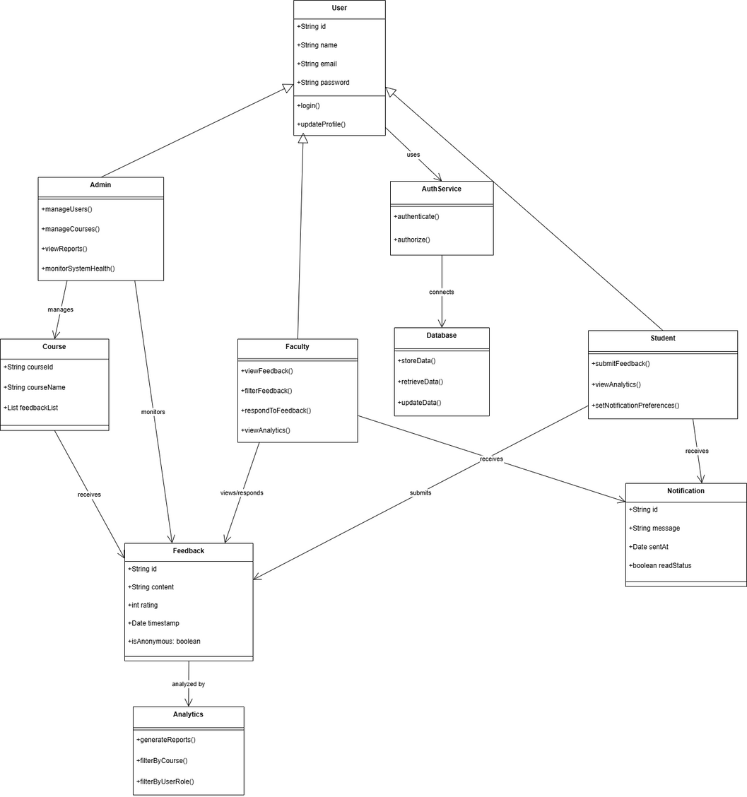
UML
DIAGRAM
Next Slide

Slide 9
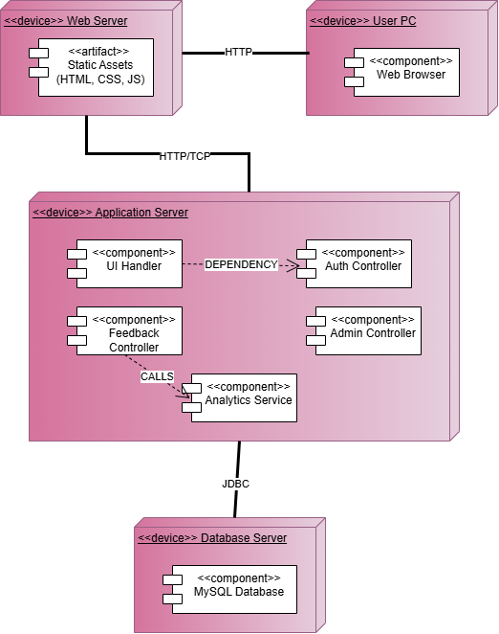
DEPLOYMENT
DIAGRAM
Next Slide

Slide 10
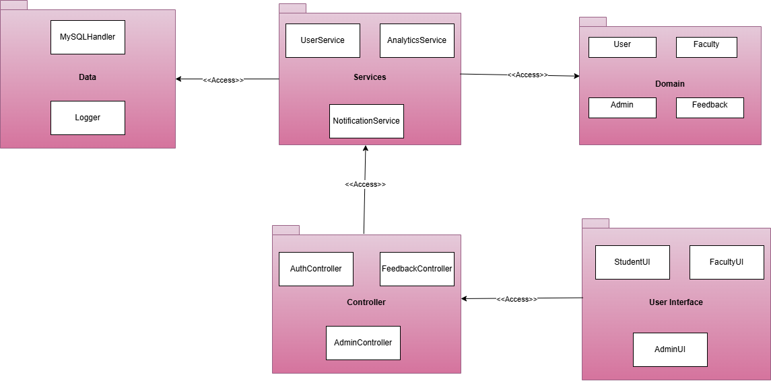
PACKAGE
DIAGRAM
Next Slide

Slide 11
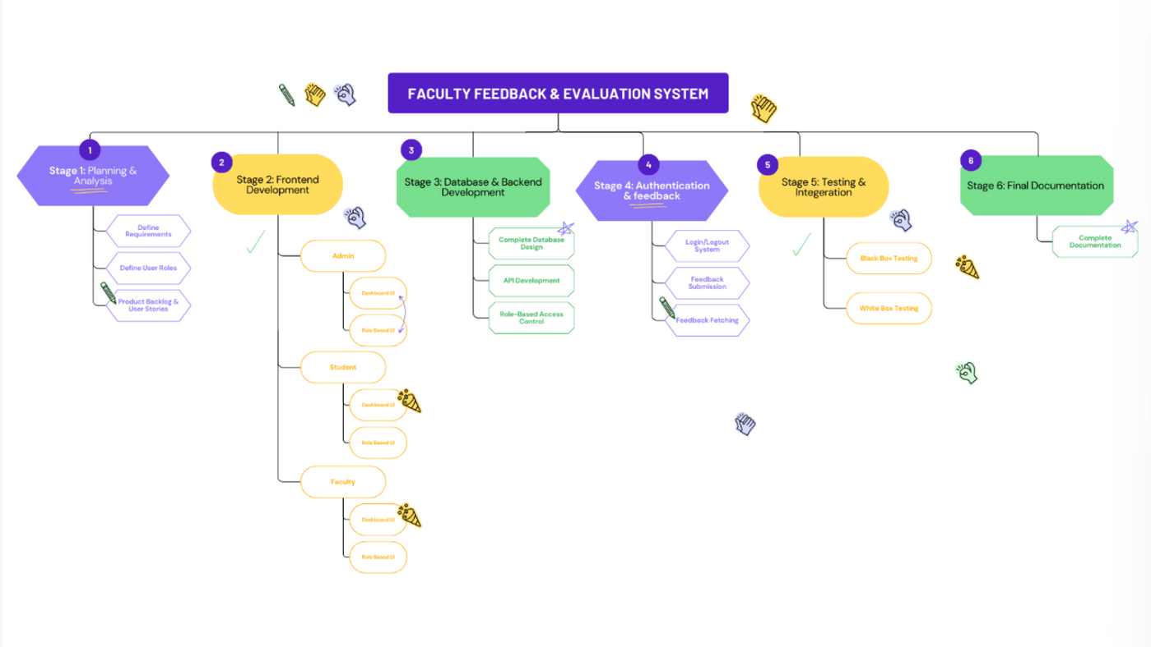
WORK BREAKDOWN
STRUCTURE
Next Slide

Slide 12
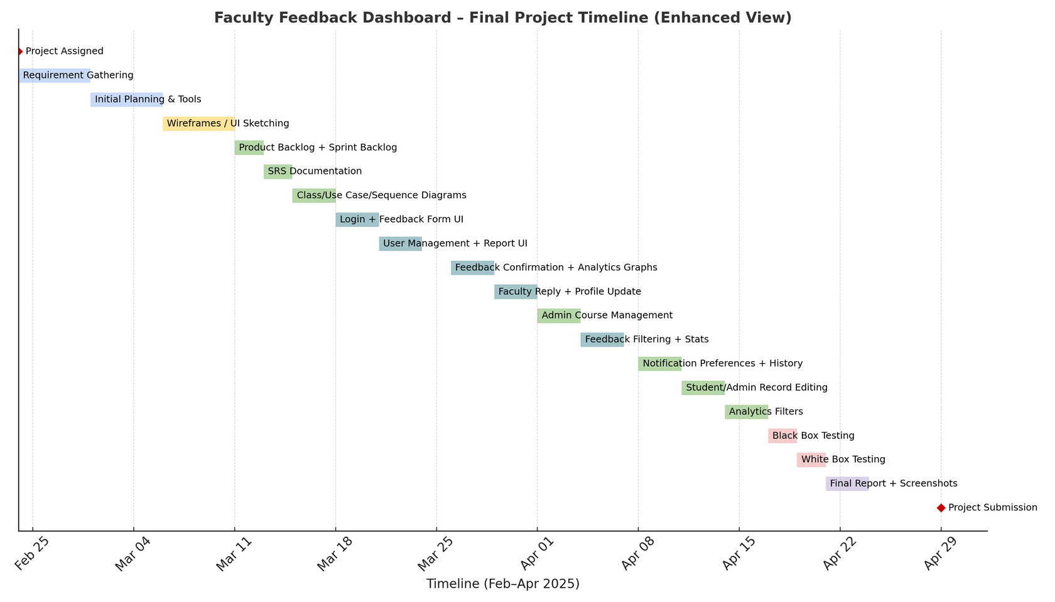
GANTT
CHART
Next Slide

Slide 13
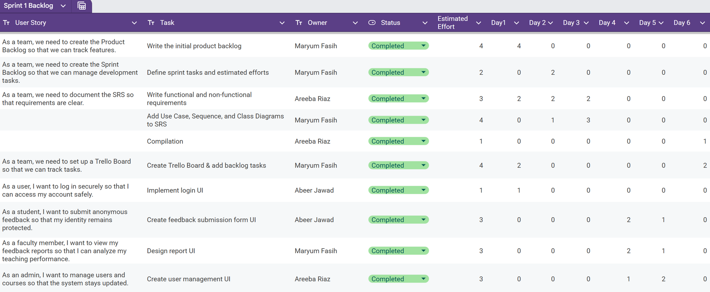
Planning
Sprint
Next Slide

Slide 14
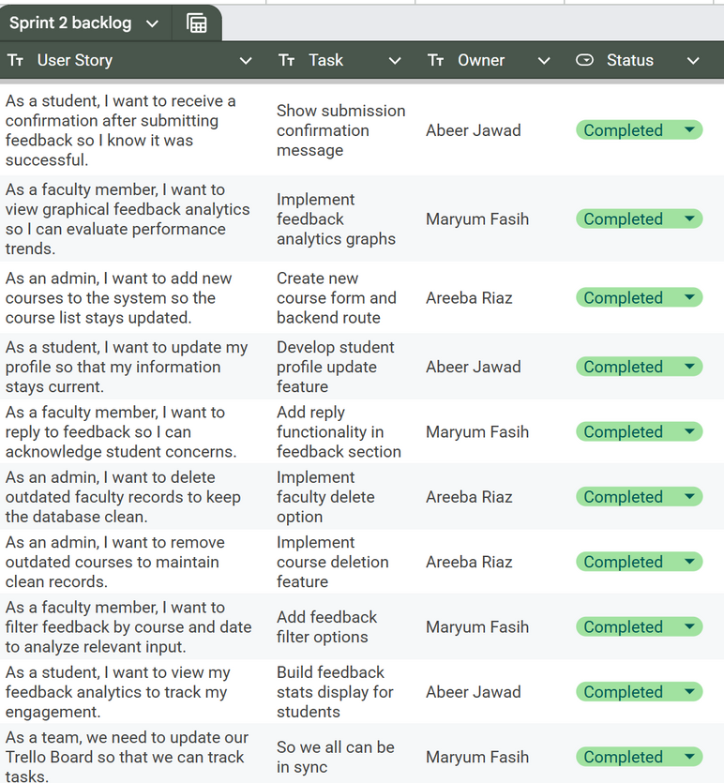
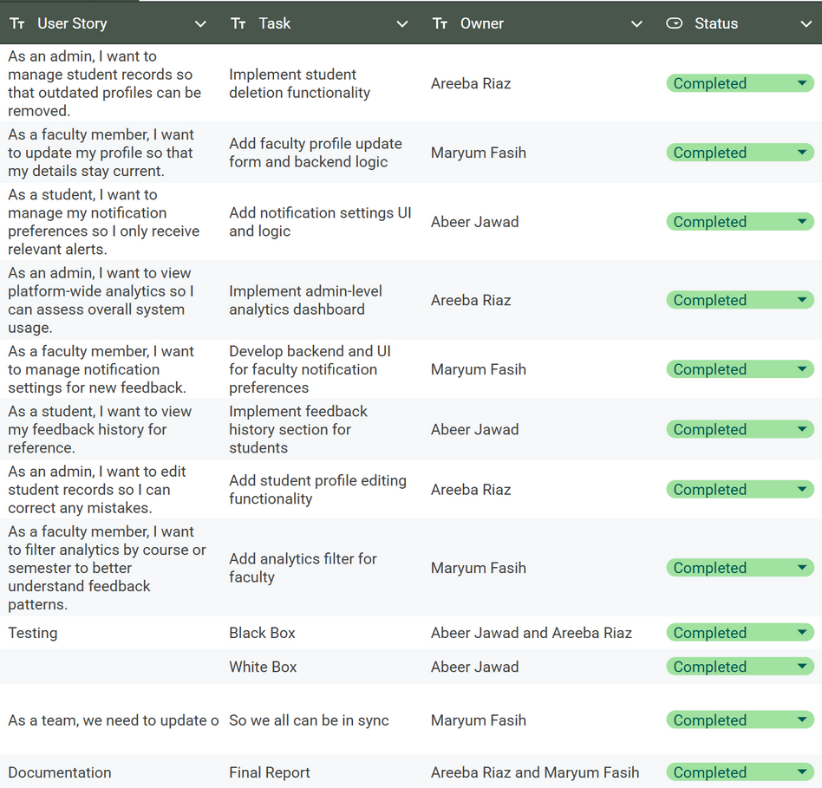
Planning
Sprint
Next Slide

Slide 15
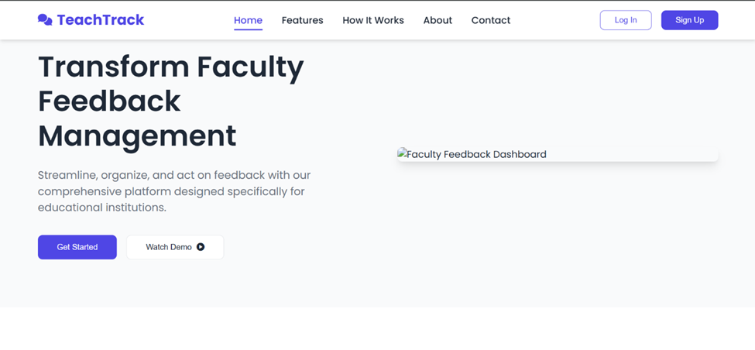
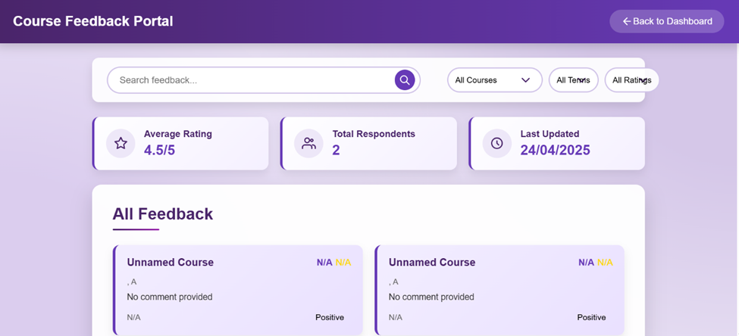
of Frontend
Glimpse
Next Slide

Slide 16
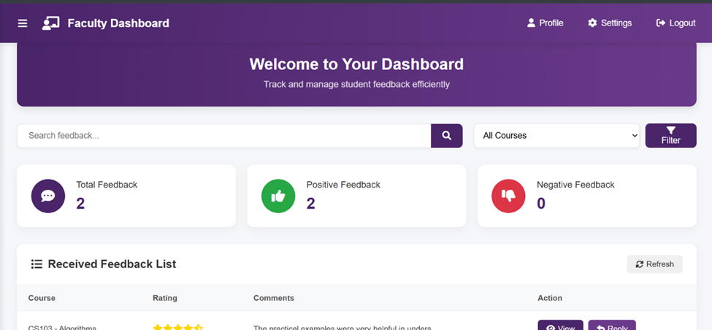
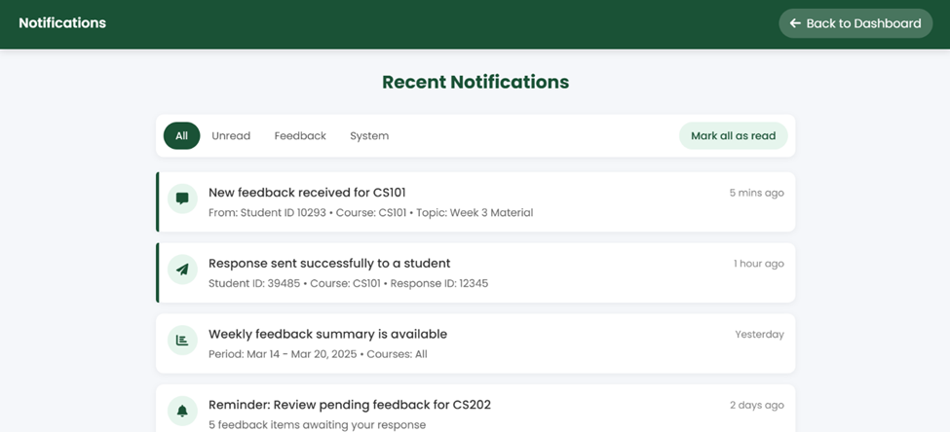
of Frontend
Glimpse
Next Slide

Slide 17
Further
Improvements
Customizable feedback forms tailored to department or course type
Dashboard customization so users can personalize the analytics they see
Voice feedback support for accessibility and convenience
Feedback reminders via email or in-app notifications to improve response rates
Export to Excel/PDF functionality for offline analysis and record keeping
Next Slide

Slide 18

Team
Division
Next Slide

Slide 19

Maryum Fasih
Scrum Master – UI Designer
Designed UI
Managed Trello and team coordination
Created Diagrams (component, pkg, etc)
Next Slide

Slide 20
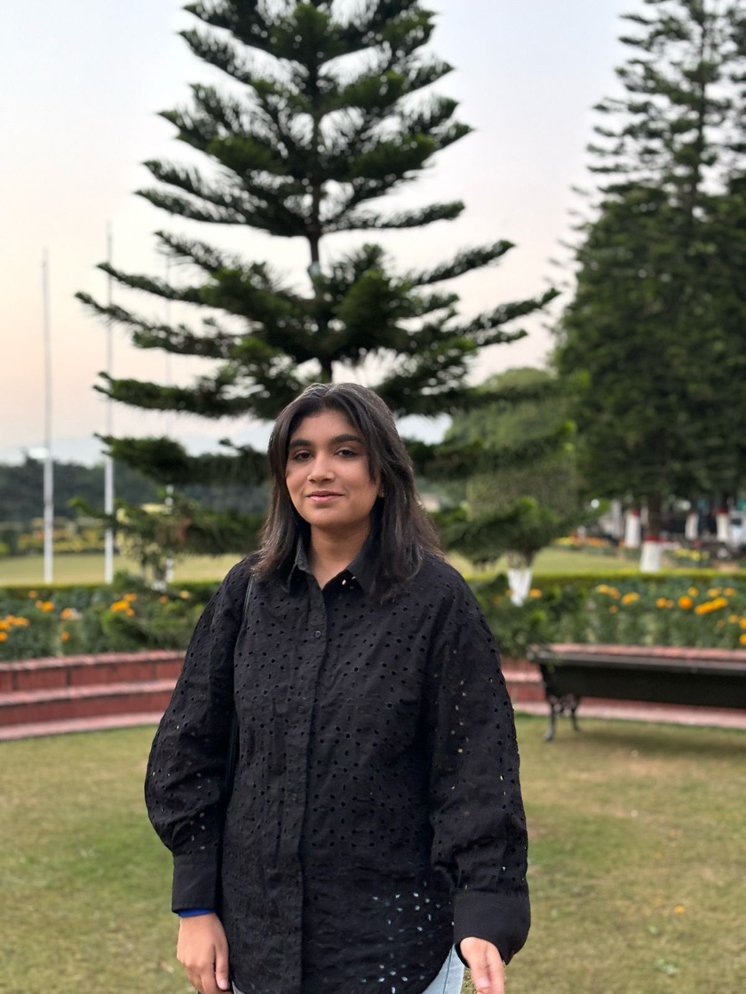
Abeer Jawad
Developer – UI/UX Designer
Handled Backend Development
Backend Integration
White Box & Black Box Testing
Next Slide

Slide 21

Areeba Riaz
Developer - Requirement Analyst
Created Database Schema
Helped in Backend
Black Box Testing
Documentation
Next Slide

Slide 22
Conclusion
Lessons learned
Understood how to build secure, role-based systems
Learned to manage real-time data and anonymous feedback
Improved integration between frontend and backend components
Team reflections
Faced challenges with time management and coordination
Regular meetings and clear task division kept us on track
Communication was key to solving integration issues
Final thoughts
TeachTrack helped us grow both technically and collaboratively
Proud of delivering a meaningful and functional system
Experience will guide us in future real-world projects
Next Slide

Slide 23
Thank
You!

